Slide 1
Great Eastern Country Zone 20 November 2023
Rebecca Bowler
Manager- Customer & Stakeholder
Goldfields & Agricultural Region
0409 293 618

Slide 2
Goldfields Pipeline Heritage Project - Update
Stories in the pipeline completed community engagement in October ’23
Heritage Management Plan and Interpretation strategy currently being finalised
Stakeholders inc. LGAs, comment period first half of 2024

Slide 3
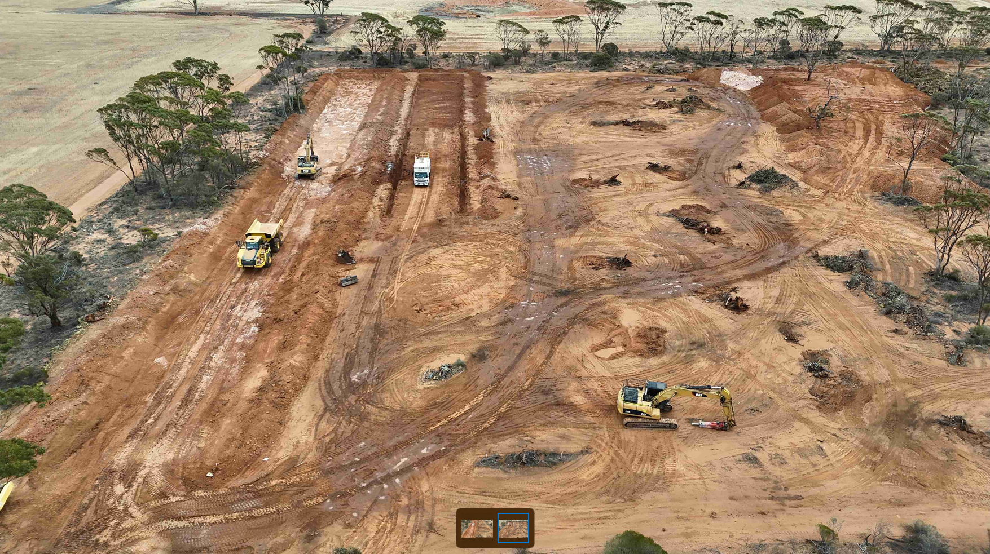
Ghooli ACM Remediation update
Workers cottages removed
Found new deposits= slight delay
Works scheduled for completion end of Feb '24

Slide 4
Farmlands pipeline renewal program
Water Corporation currently has six local and seven Aboriginal contractors (3 Joint Ventures) bidding for Farmlands Projects.
Packages of work are prioritised based on water quality and asset related risk factors.
The current stage (9) is currently on track with:
Two packages of work completed : Kellerberrin Shire and Wyalkatchem Shire;
Two packages of work currently in construction : Northam Shire and Koorda Shire; and
Two contracts still to be awarded
The Business Case for Stage 10 has been completed and submitted and will be ready for delivery in the 2024-2025 financial year.
Stage 10 works in the Shires of : Wongan-Ballidu, Mukinbudin, Kellerberrin, Cunderdin and Merredin.
Stage 10 will be the final stage in this five year program of replacement works.
The next five year program is currently being developed with the pipeline earmarked for replacement being prioritised accordingly.
Water Corporation is pleased to have coached and upskilled local contractors to better enable their successful bid for other government and local authority work.

Slide 5
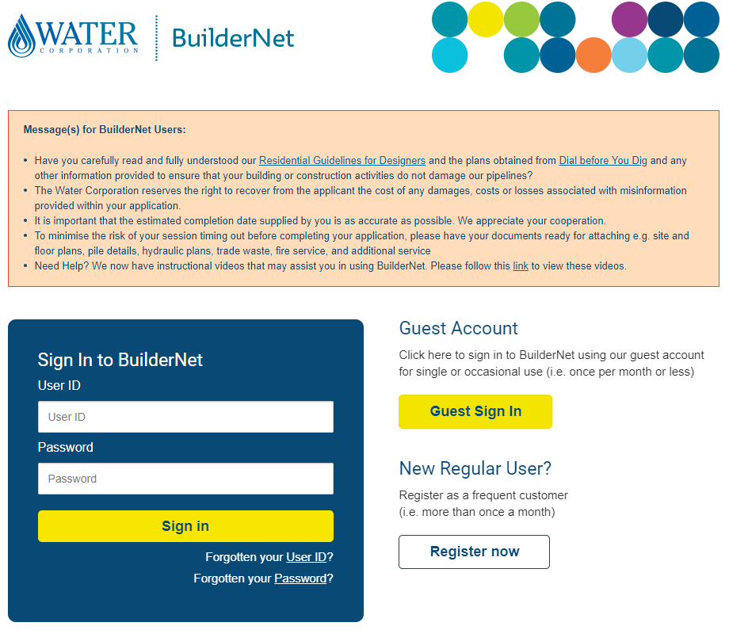
LGAs vital role in understanding GAWS demand
Important to understand development requirements in a changing “climate”
Infrastructure investment decisions in-part driven by “high likelihood” scheme demand
LGAs are the “first touch” in development application process
Please send them our way… “turn aspirations into applications/service enquiries”
Please direct all development enquiries to Development Services:
https://www.watercorporation.com.au/Developing-and-building/Subdividing/Request-servicing-advice

Slide 6
Questions?
0409 293 618

